Slide 1
UNIFIED MODELING LANGUAGE

Slide 2
Tutorial contents
UML basic
Use case diagram
Class diagram
Activity diagram
Sequence diagram
StateMachine diagram

Slide 3


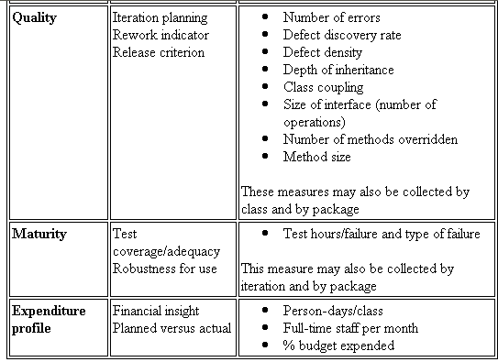


UML Diagram – What is UML?
The Unified Modeling Language (UML) is a standard language for
Specifying
Visualizing
Constructing
Documenting
Business Modeling
Communications

Slide 4
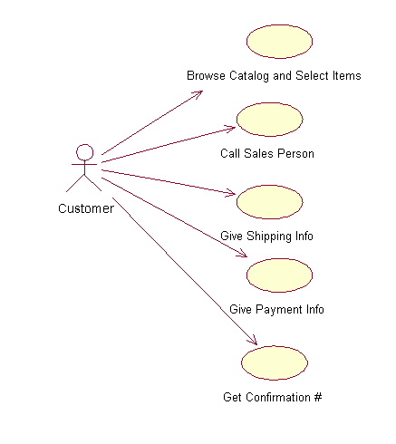
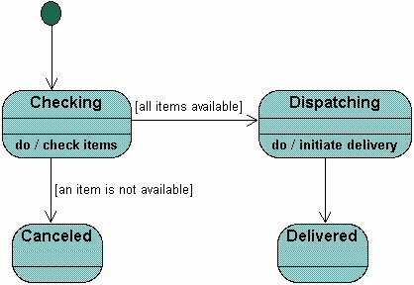
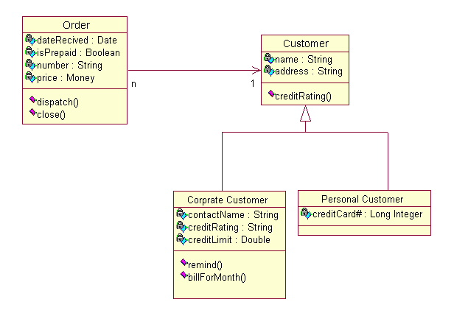
Different Views
Users
Designers
Analyzers

Slide 5
Use case diagram
System boundary
Actor
overview the usage requirements
presentations project stakeholders
"the meat" of the actual requirements
Use case:
A use case describes a sequence of actions that provide something of measurable value to an actor and is drawn as a horizontal ellipse
System boundary:
indicates the scope of your system. Anything within the box represents functionality that is in scope and anything outside the box is not
Actor:
An actor is a person, organization, or external system that plays a role in one or more interactions with your system
Use case
Online C2C shopping

Slide 6
Class Diagram
Name
Class diagrams show the classes of the system, their interrelationships (including inheritance, aggregation, and association), and the operations and attributes of the classes.
Associations
Aggregation
Generalization
Relations
Attributes
Operations

Slide 7
Relationships between Class Diagrams
Association -- a relationship between instances of the two classes. There is an association between two classes if an instance of one class must know about the other in order to perform its work. In a diagram, an association is a link connecting two classes.
Aggregation -- an association in which one class belongs to a collection. An aggregation has a diamond end pointing to the part containing the whole.
Generalization -- an inheritance link indicating one class is a superclass of the other. A generalization has a triangle pointing to the superclass.

Slide 8
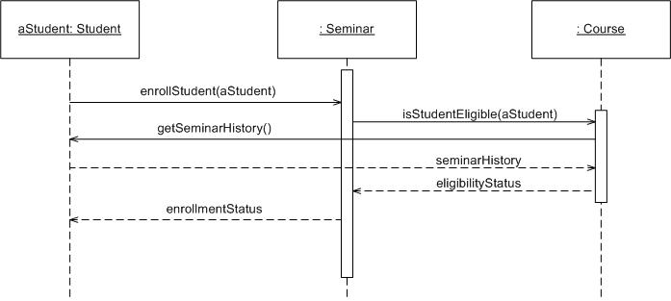
Sequence Diagram
Object: Class
A sequence diagram is
An interaction diagram that details how operations are carried out.
What messages are sent and when.
Sequence diagrams are organized according to time
Message
Operations
Lifeline

Slide 9
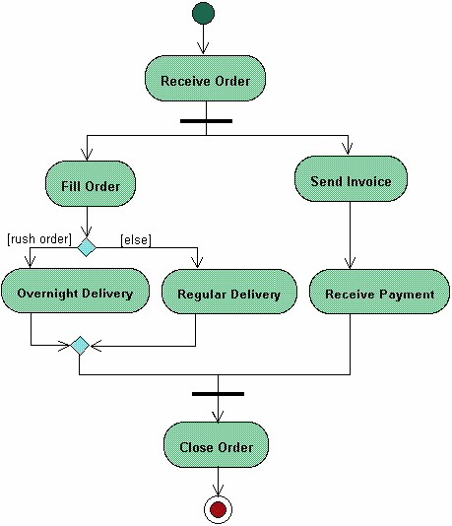
Activities Diagram
Start
Activity diagrams describe the workflow behaviour of a system
Fork
Branch
Merge
Joint
End

Slide 10
State Machine Diagram
A State Machine diagram
shows the possible states of
the object and the transitions
that cause a change in state.

Slide 11
Practices Section
Practice example:
Library System
New Borrower can register
Book Acquisition
Borrowing and Returning
Check Book Availability

Slide 12
Some UML Modeling Techniques
Unified Modeling Language
UML (Unified Modeling Language) is a standard notation for the modeling of real-world objects as a first step in developing an object-oriented design methodology.
Class Diagrams
Use Cases/Use Case Diagrams
Interaction Diagrams
State Diagrams

Slide 13
Use-Case Modeling
  An actor represents anything that
  interacts with the system
  A use case is a “chunk” of functionality performed by a system, yielding a measurable result of value for an actor

Slide 14
A use case diagram is drawn to illustrate that use cases and actors interact by sending stimuli to one another
Customer
Conduct Bank Transactions
Bank
Run Reports
Maintain ATM Machine
ATM Maintainer

Slide 15
Building an OO Dynamic Model
Identify use cases
Describe each use case through an interaction diagram
For more complex objects, provide a state diagram per class
Derive implied methods (and attributes)

Slide 16
Example:
Class Diagram
Borrower
0..1
0..3
Book
currBorr
bk[]
public class Borrower {
Book bk[];
…
public Borrower() {
bk = new Book[3];
}
}
public class Book {
Borrower currBorr;
…
}

Slide 17
Building an OO Dynamic Model
Scenario
Object (State, Behavior, Identity)
Interaction Diagrams
Sequence Diagrams and Scripts
Collaboration Diagrams
Link Notations
Classes and Objects

Slide 18
Example:
Use Case Diagram
LIBRARY SYSTEM
Facilitate Checkout
Search for Book
Borrower
Librarian
Facilitate Return

Slide 19
Example:
Interaction Diagram
2: isAvailable()
Checkout
Screen
:Book
1: borrowAllowed()
3: borrowBook()
4: setBorrower()
:Borrower

Slide 20
Example:
State Diagram (Book)
start
Reserved
New
Borrowed
Librarian activates
book as available
Borrower returns book
Available

Slide 21
Object-Oriented Design Models
Static Model
  Class Diagrams
Dynamic Model
  Use Cases, Interaction Diagrams, State Diagrams, others

Slide 22
OO Static Model
Classes and Class Diagrams
Relationships
  Association
  Aggregation/Composition
  Inheritance
Dependencies
Attribute and Method names

Slide 23
OO Dynamic Model
Goal: Represent
  Object behavior
  Object interaction
Traditional/Procedural Dynamic Modeling
  Data Flow Diagrams (DFDs)
  Problem: Processes separate from data
  Need modeling notation that highlight tight relationship between data & processes

Slide 24
DFD Example
(Inventory Management)
Accept and Post
Delivery
Delivery info
Transaction
Item Master

Slide 25
OO Counterpart:
Object Interaction
new (delivery info)
Encoder
:Transaction
post (item count)
:Item Master

